Slide 1
Smart Taj
Hotel Management System

Slide 2
Members Details
Name | Student ID
Paras Movaliya (Team leader) | 201901027
Vishvarajsinh Chauhan | 201901015
Karan Solanki | 201901085
Mayur Pandar | 201901090
Yash Prajapati | 201901120
Milan Vadheri | 201901121

Slide 3
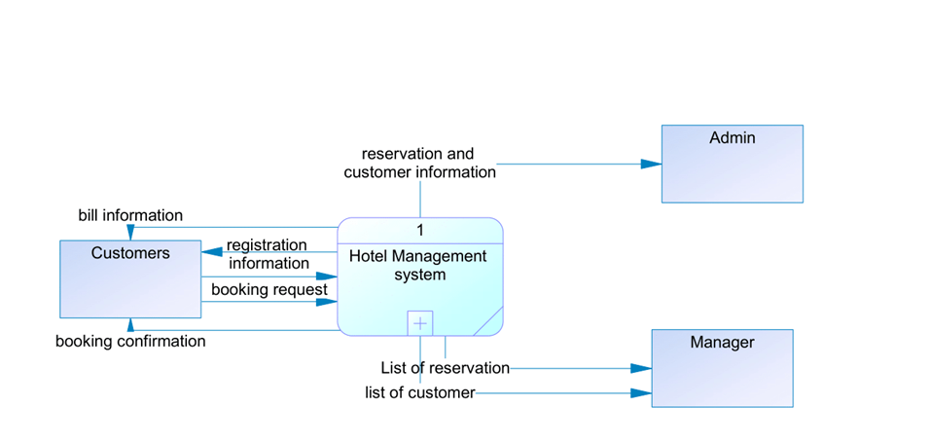
Context Diagram

Slide 4
Functional Summary (User Stories)
Search room: Users can request a room booking for a particular date and time. There are mainly two types of rooms available, like a single and double bed with AC and Non-AC. Users can choose as per their choice. Users can also see the remaining time of already booked room for the future booking reference.
Booking & order information: System provides the unique code for each customer. This helps to store all the booking and order details for that particular customer.
Order food: Customer can see the online menu card from the website and order the food providing the code/food name of the food from the menu card and the quantity as their preference.
Payment Details: When customer wants to leave the hotel, they can enter their booking information for the payment. Customers must pay using one of the available payment methods, such as cash, net banking, or an ATM card.To clear payment, the payment portal would use a payment gateway.

Slide 5
Functional Summary (User Stories)
Room cancellation: Users have a choice to cancel their room (if booked) but in that case, they will not get 100% of their money.
Manage Staff: Admin can see the staff member details like staff member name, phone number, bank account number and track record of all the staffs in the hotel.
Manage User: Admin can see the all users details to see the frequency of the customer and also payment paid by the customer. Admin/Receptionist can update the customer details according to customers latest information.
Help desk: Customer can call the staff for any query using help button on the website.
Manage inventory: Admin/Owner can see the total (food + furniture) inventory used and what number of inventories was in stock. If the stock is below the threshold value than manger has to immediate order the appropriate number of inventories using the previous data. (Threshold value is calculate using the previous month’s used inventories).

Slide 6
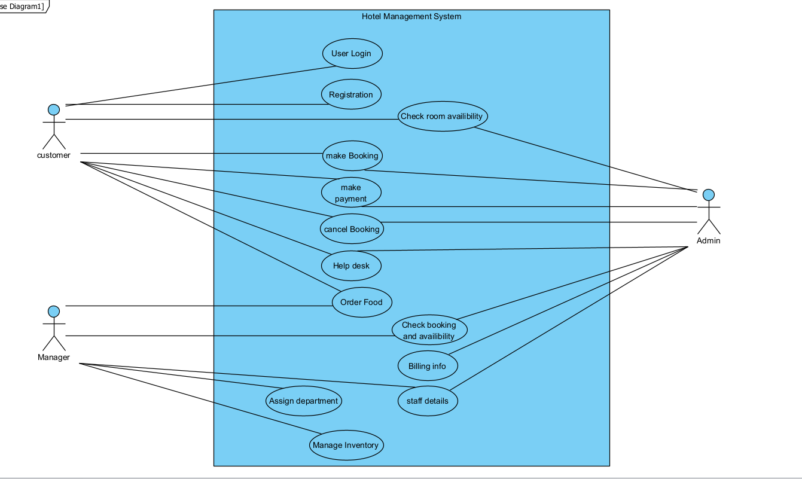
Top Level Use Case Model

Slide 7
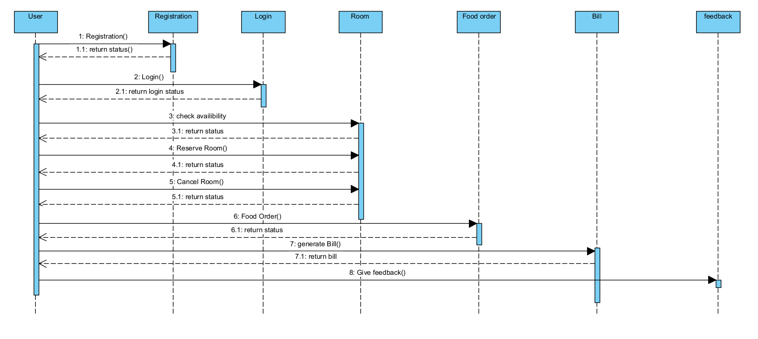
Sequence Diagram

Slide 8
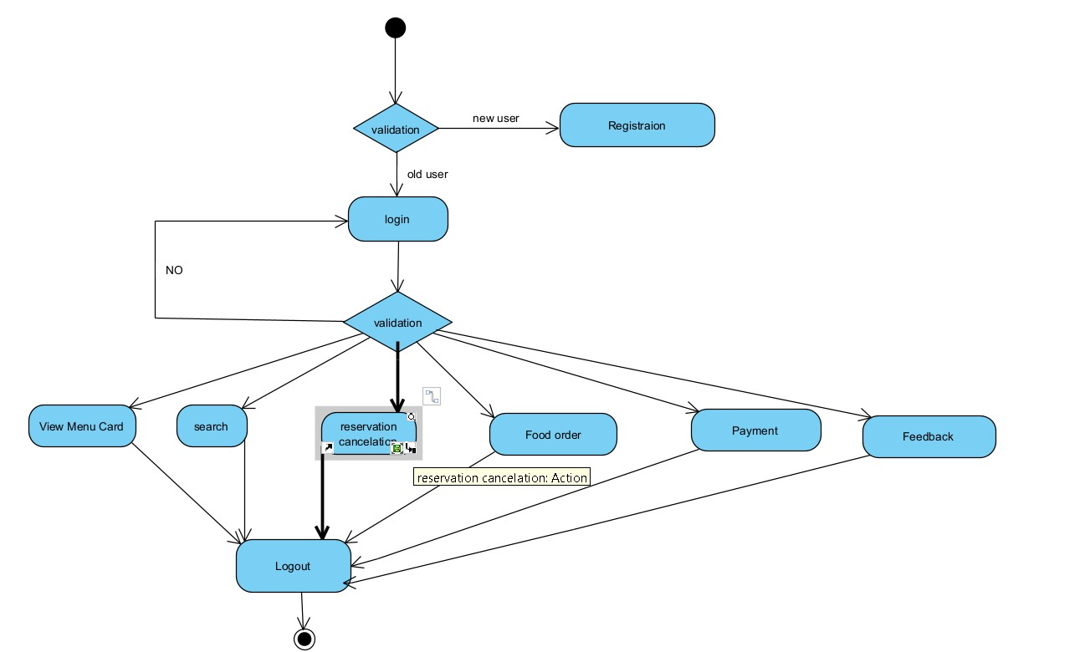
Activity Diagram

Slide 9
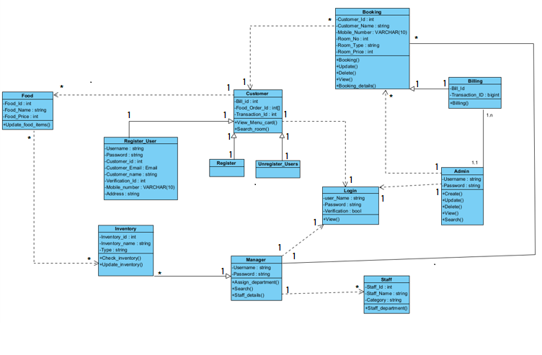
Class Diagram

Slide 10
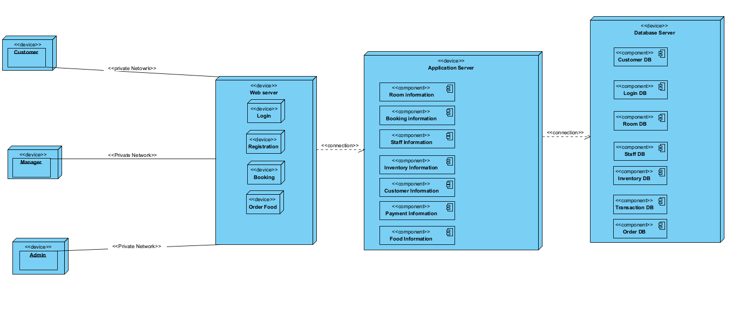
Deployment Diagram

Slide 11
Scrum Methodology
We use scrum methodology for our development.
Scrum is an agile development methodology used in the development of Software based on an iterative and incremental processes.
We created Product backlog, Sprint backlog for handling the user stories.
There are many benefits of the scrum methodology like it is easily scalable, Flexible to changes, Time to market reduction, Higher software quality, Reduction to risks, etc.

Slide 12
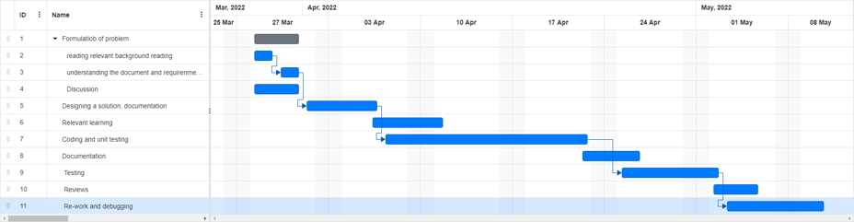
Gantt Chart
.

Slide 13
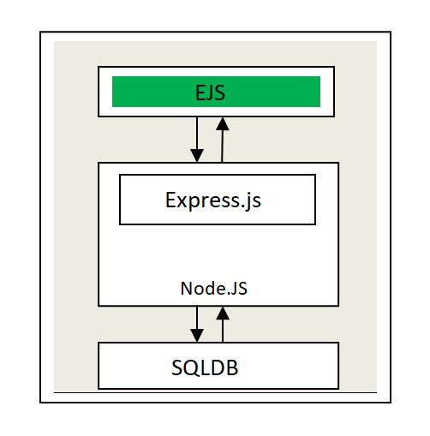
Application Architecture
.

Slide 14
Technologies/Tools and Libraries
Vs Code, Hyper, bash
Node JS, Express
EJS
HTML, CSS, JS
Postgres
Bootstrap, Google Icons
npm

Slide 15
Summary of Implementation
To handle the coding component, we primarily used Visual Studio Code and Terminal. Many extensions are available for Visual Studio Code, which improves the development experience.
We used the "express" Node-JS framework as a technology. In comparison to writing a backend in Node, using express is a lot easier. Node-JS and EJS are JS libraries which are used in our front and backends. EJS templating is used to develop multi page web pages in a more straightforward manner.
we utilised SQL as a database, we used the "pg" package to handle Node-postgres connections.
We built the front and backends, as well as connected Rooms database, using Express, EJS and Postgres.

Slide 16
Schema and Relation of databases
In database, for transection management, availability and consistency we used sql database.
relation with schema:
customer(C_ID,name,address,email,username,password,mobile number)
room(R_ID,bad,price,type)
order(O-ID,discount,total amount)
payment(T-ID,types)
inventory(Item-ID,price)
customer,room and transection(C-ID,R-ID,T-ID)
customer and order(C-ID,O-ID)
inventory and order(I-ID,O-ID)
transection and order(T-ID,O-ID)

Slide 17
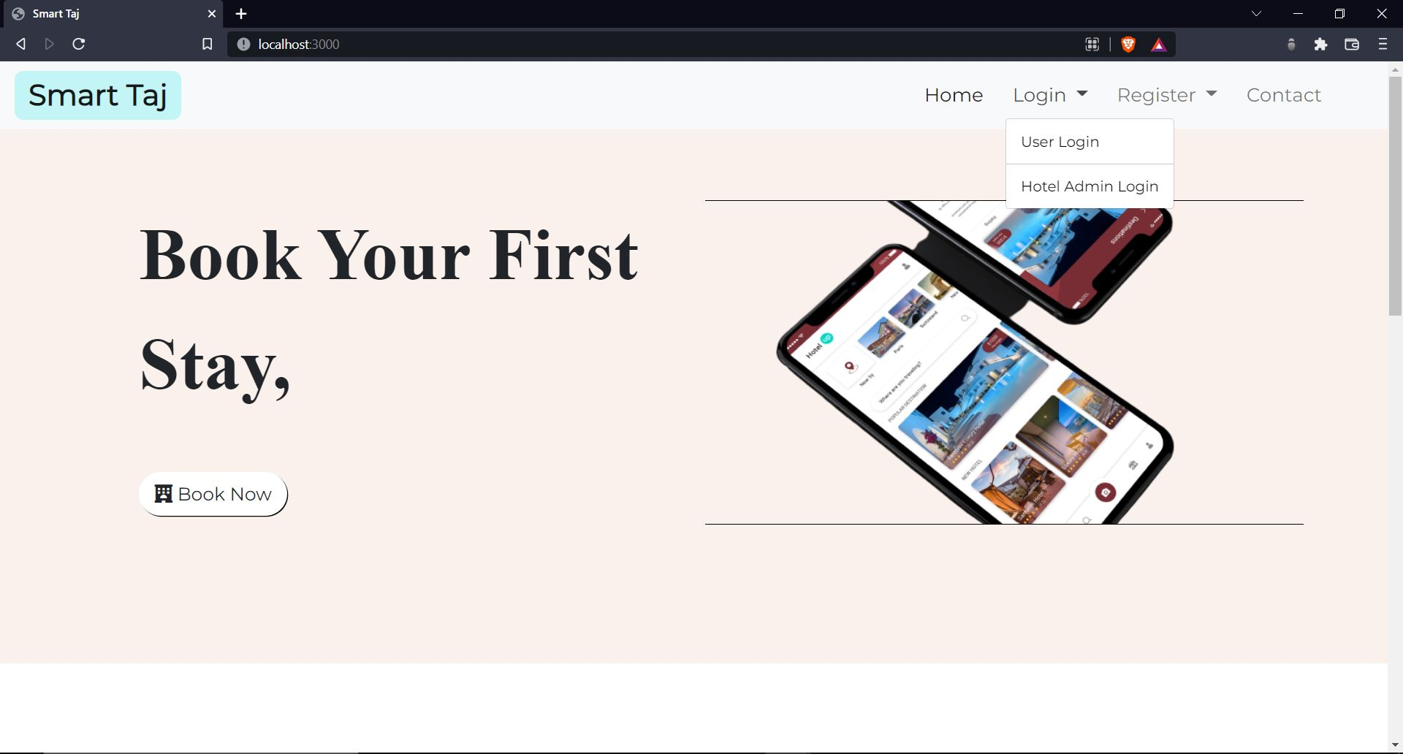

Slide 18
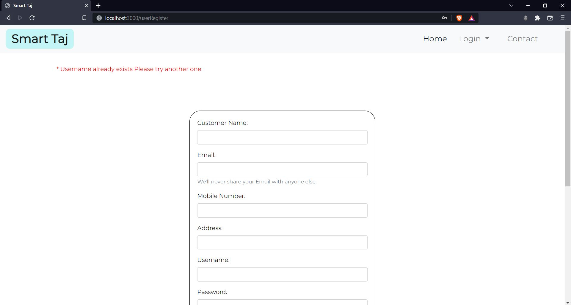

Slide 19
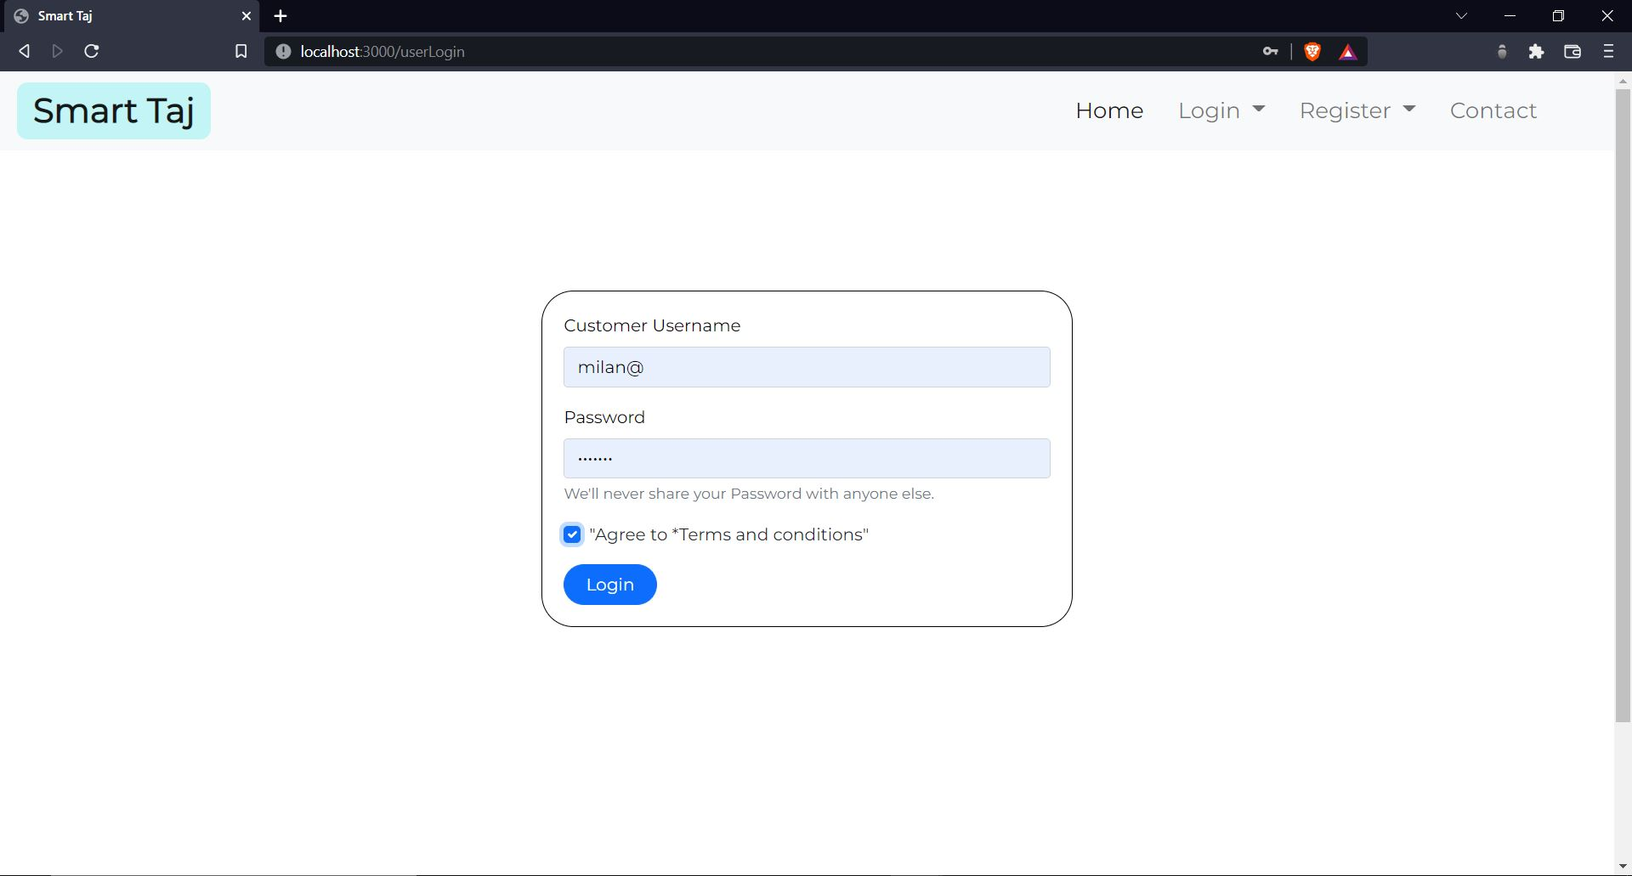

Slide 20
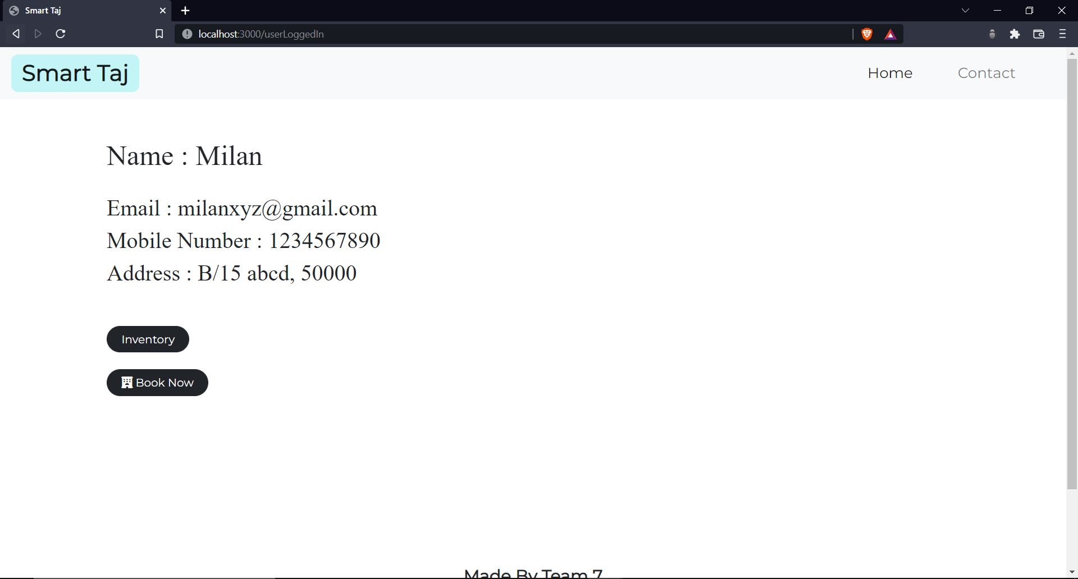

Slide 21
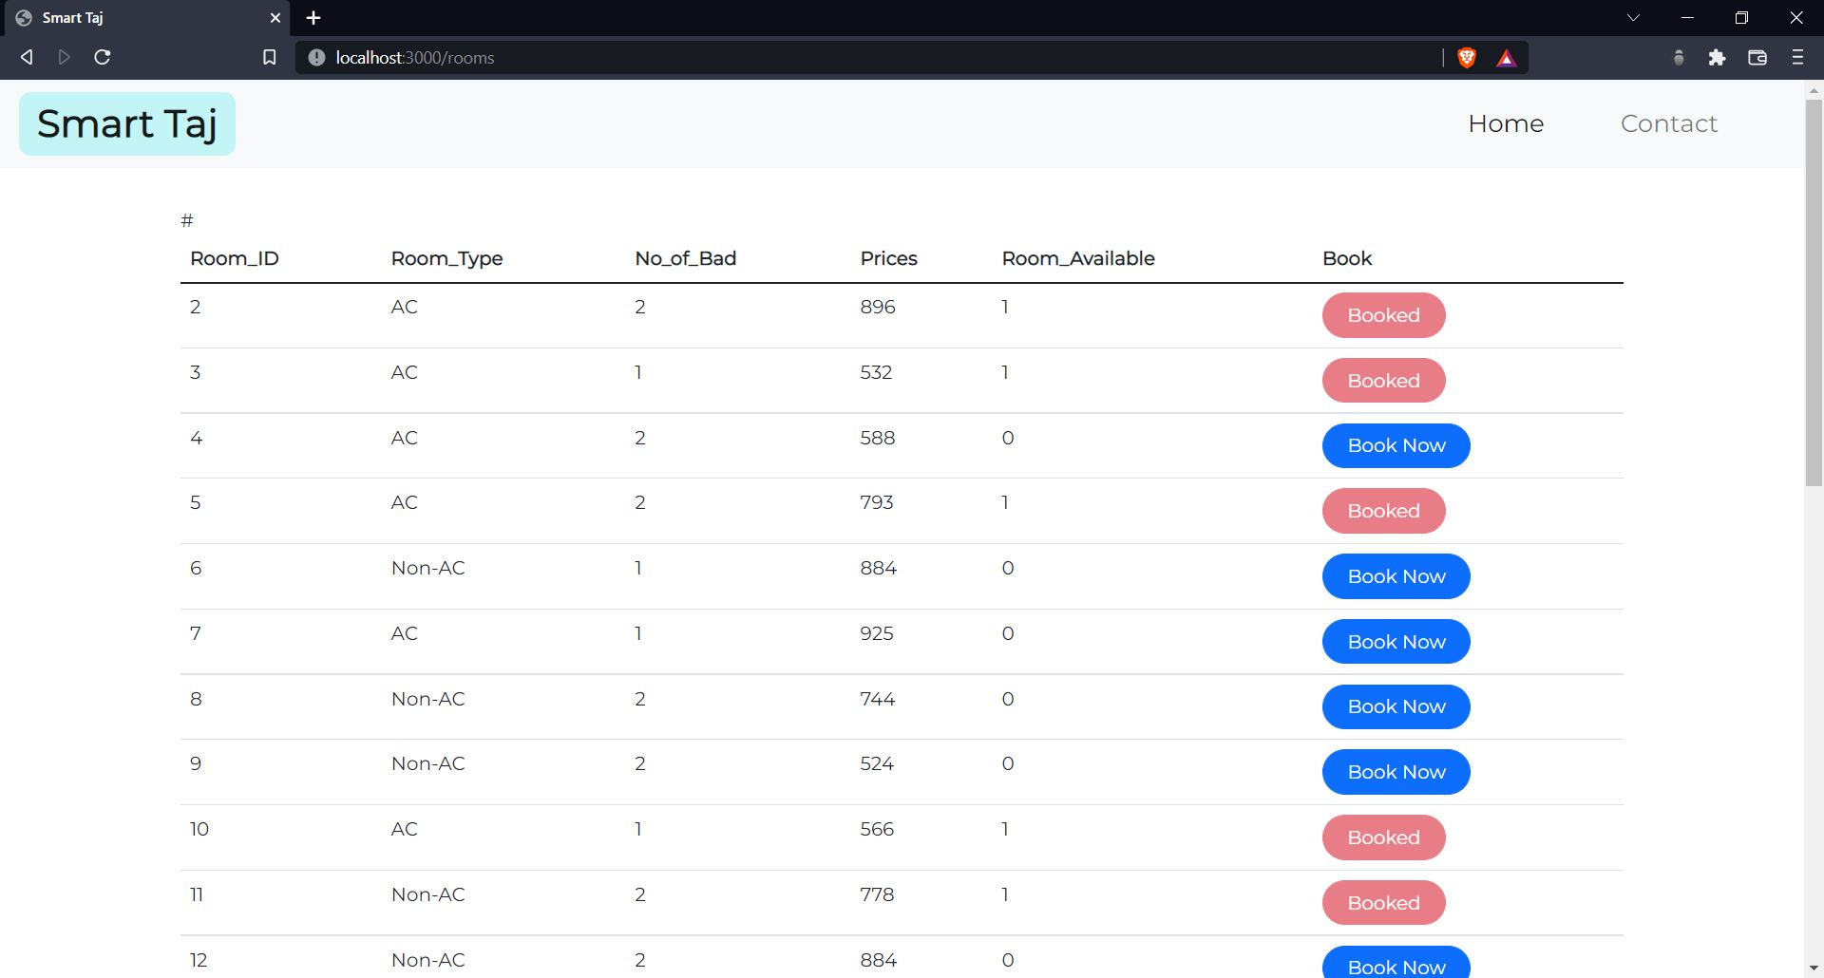

Slide 22
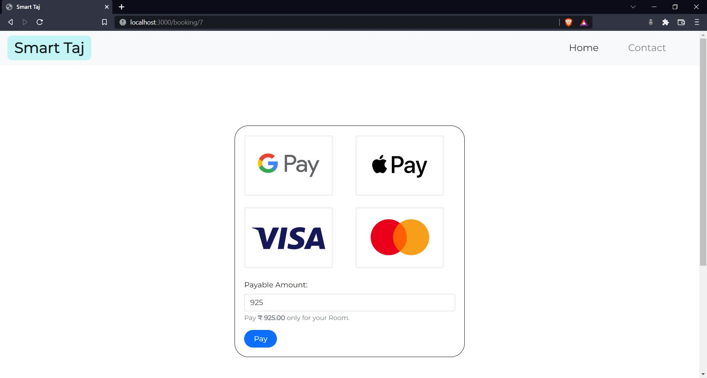

Slide 23
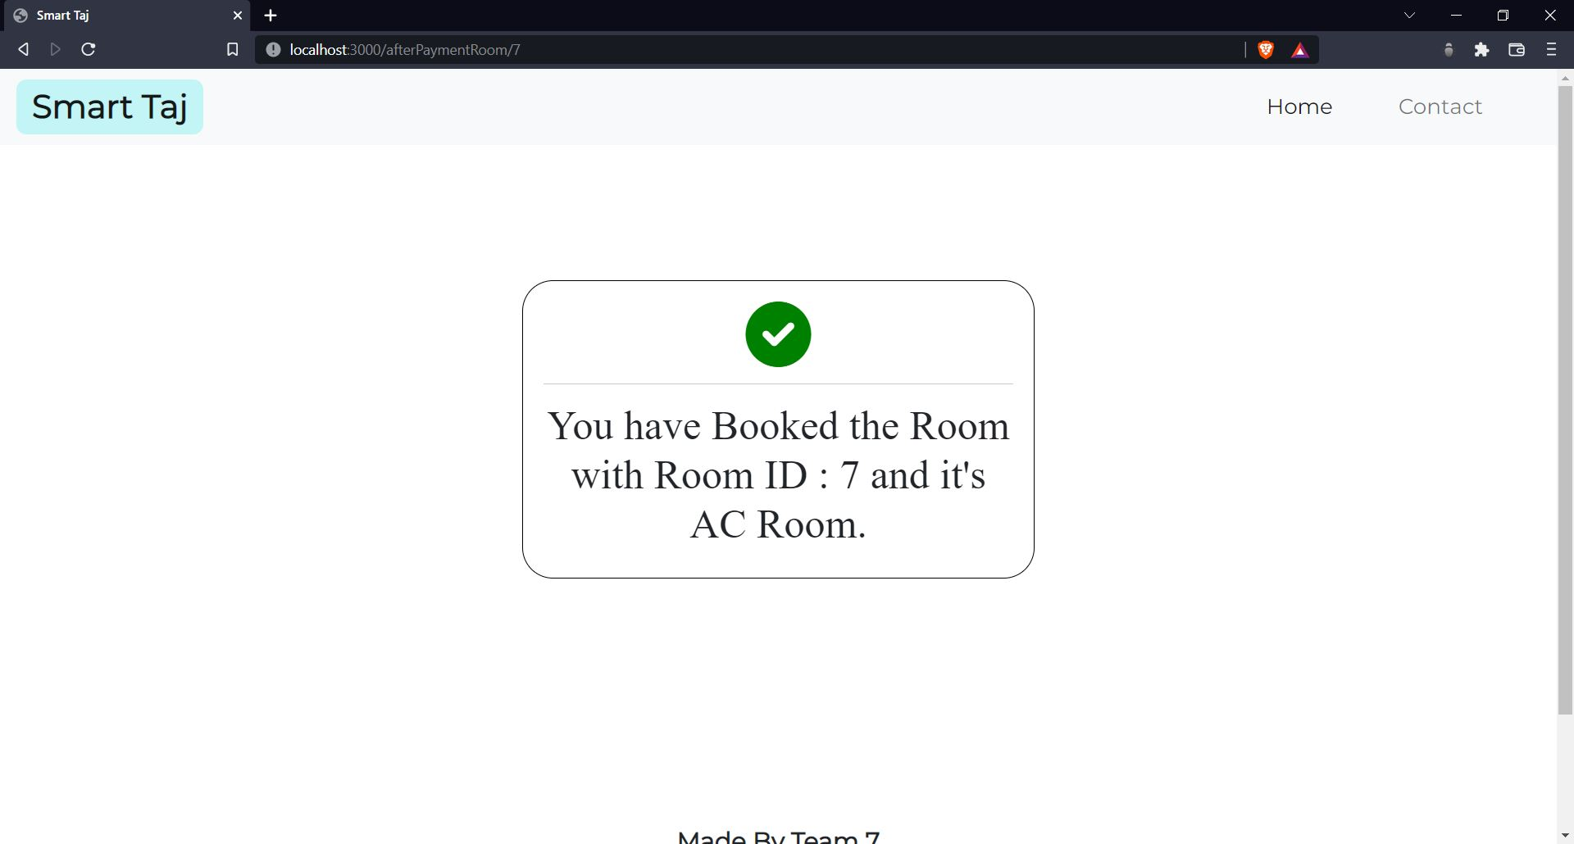

Slide 24
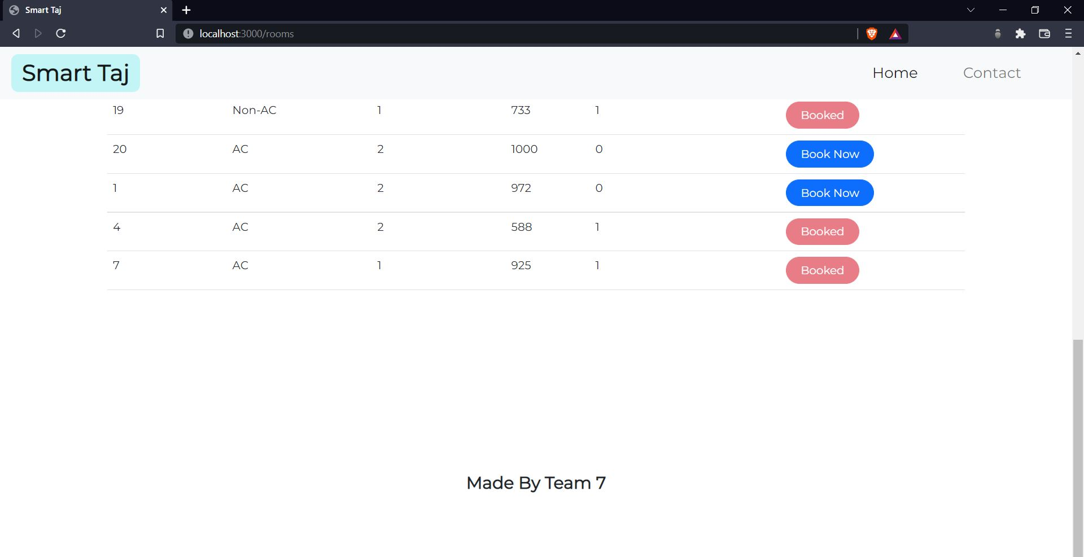

Slide 25
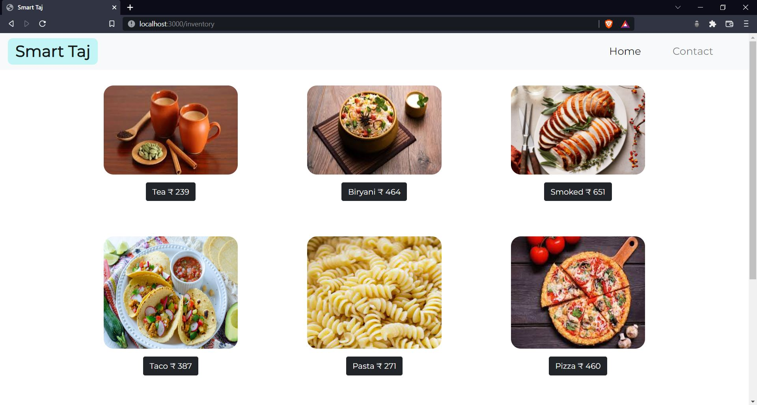

Slide 26
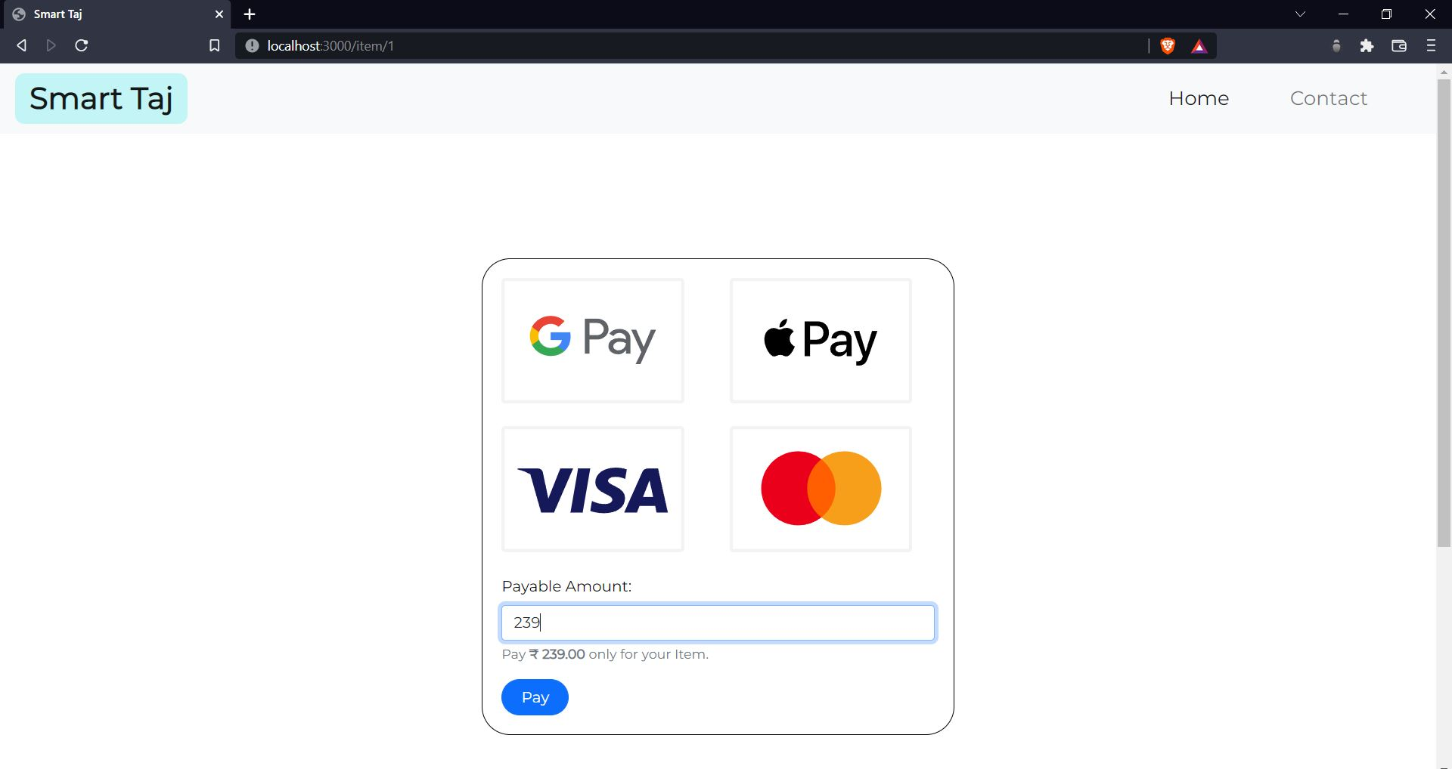

Slide 27
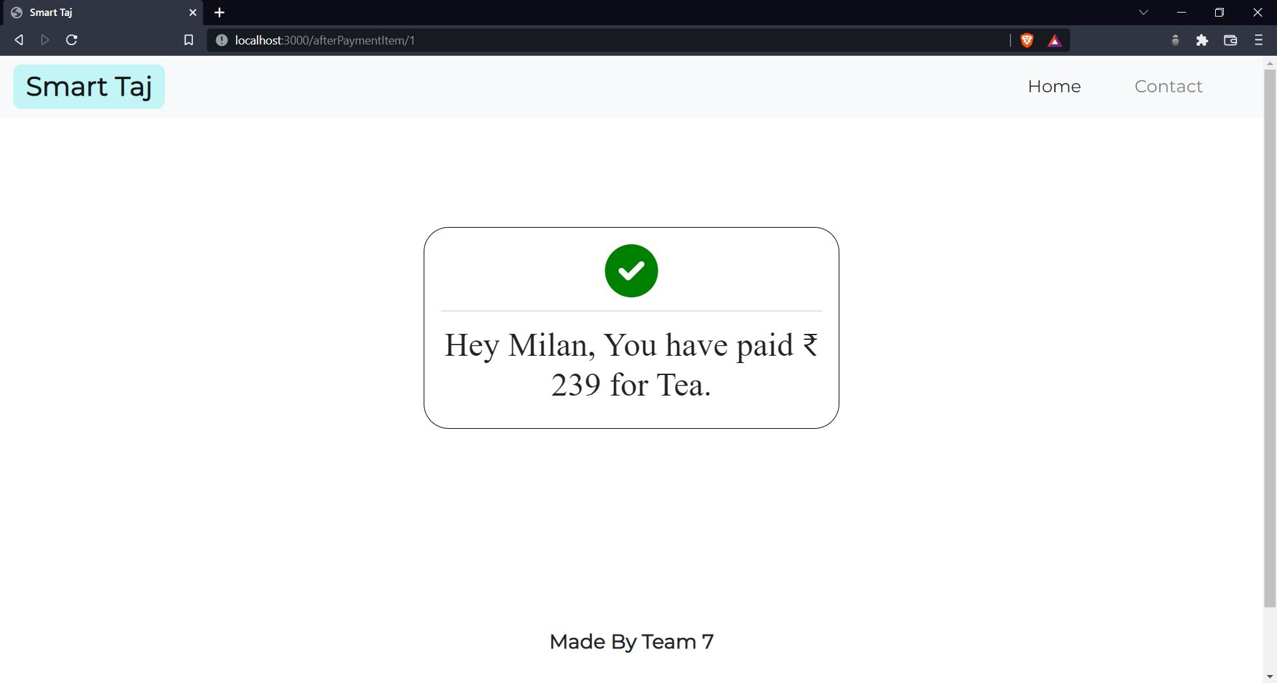

Slide 28
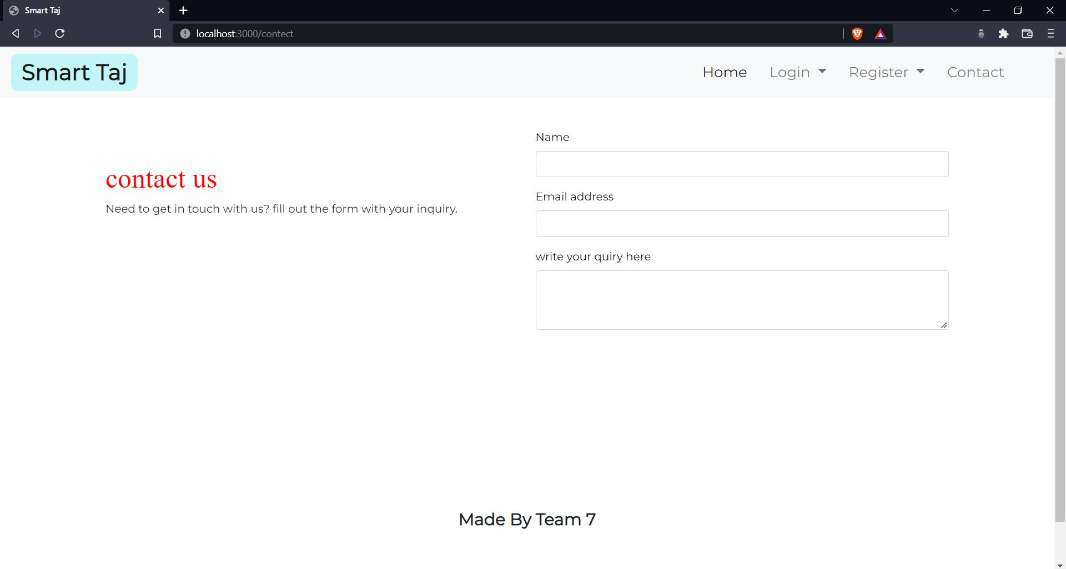

Slide 29
Contribution Details
Paras Movaliya (201901027)
System design,Structural diagram and Behavioral diagram
Vishvarajsinh Chauhan (201901015)
System design,Structural diagram and Behavioral diagram
Karan Solanki (201901085)
Development(frontend-backend)

Slide 30
Contribution Details
Mayur Pandar (201901090)
Work on VP tool and Visual Paradigm tool
Yash Prajapati(201901120)
Development(frontend-backend)
Milan Vadheri(201901121)
Database design and Development

Slide 31
GitHub Link For the Project
https://github.com/DesipherKunal/Hotel-Management-
Also, the same documentation and source code are uploaded on this drive.
https://drive.google.com/drive/folders/1v1knEBHDjU-e_CKeFz-ESJJQCYKIvHJT?usp=sharing

Slide 32
THANK YOU!

